Slide 1

BHASHA-BRIDGE
A BRIDGE THAT LINKS ENGLISH AND BENGALI SPEAKERS
Notes:
GET READY FOR THE JUNGLE!!!!!!!!!!!

Slide 2
BHASHA-BRIDGE
What problems do we see
Communication Barrier
Lack of Real-Time Solutions
Intercultural exchange
Multilingual work-environment
Whom can this help
Travellers
Businesses
Educational institutions
Non-profit organizations
Governments
A BRIDGE THAT LINKS ENGLISH AND BENGALI SPEAKERS
Notes:
- ASKING PUBLIC - David
- HYPOTHETICAL SITUATION - David, Tanu
- DEMO TIME - Alex
- NEXT SLIDE -

Slide 3
What problems do we see
Communication Barrier
Lack of Real-Time Solutions
Intercultural exchange
Multilingual work-environment
Whom can this help
Travellers
Businesses
Educational institutions
Non-profit organizations
Governments
Notes:
- PROBLEMS - David
- TARGETS - Tanu
- NEXT SLIDE -

Slide 4

Our Model
How it Works
Speaker 1 Language
Speaker 2 Language
Transcribed Text
Translated Text
Notes:
- WORKFLOW – Tanu
Tanu (2 models)
STT
GENDER RECOGNITION
David (2 models)
TTT
TTS
- NEXT SLIDE -

Slide 5
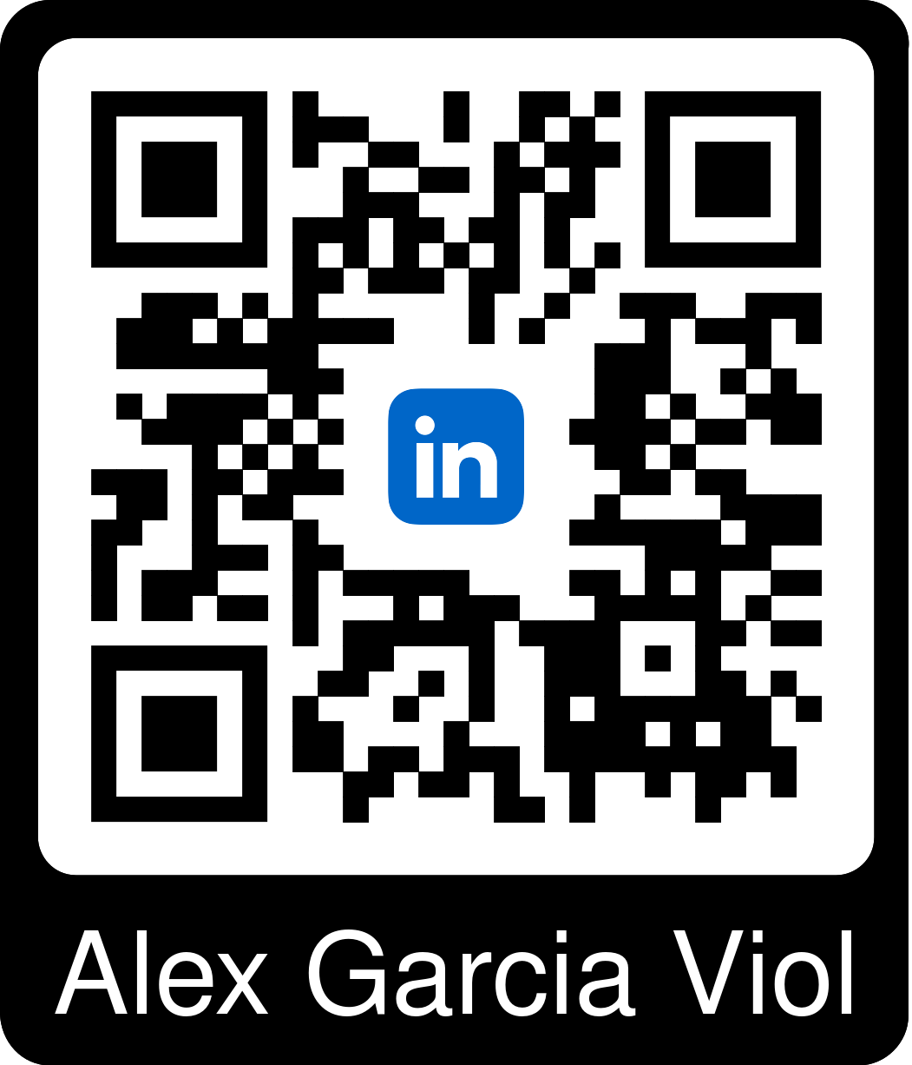
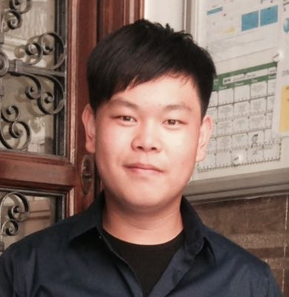
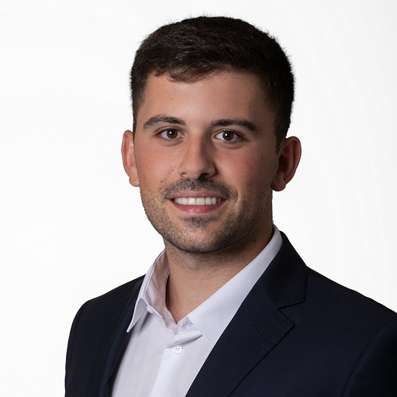
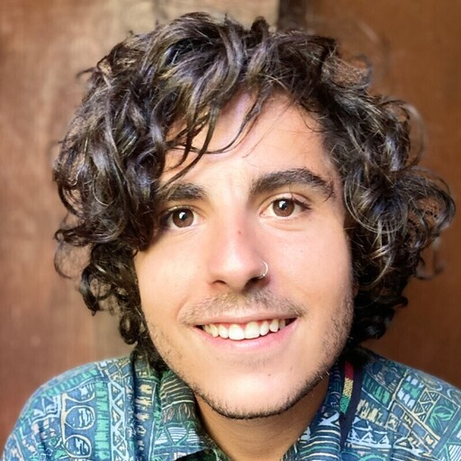
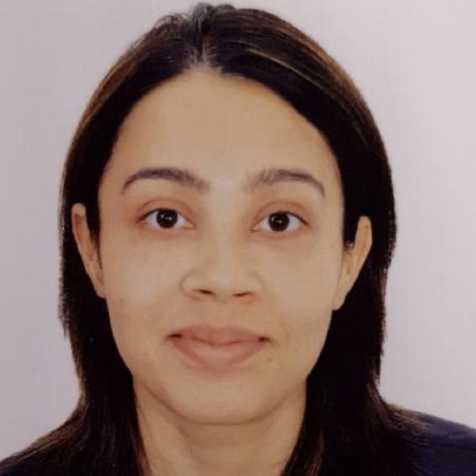
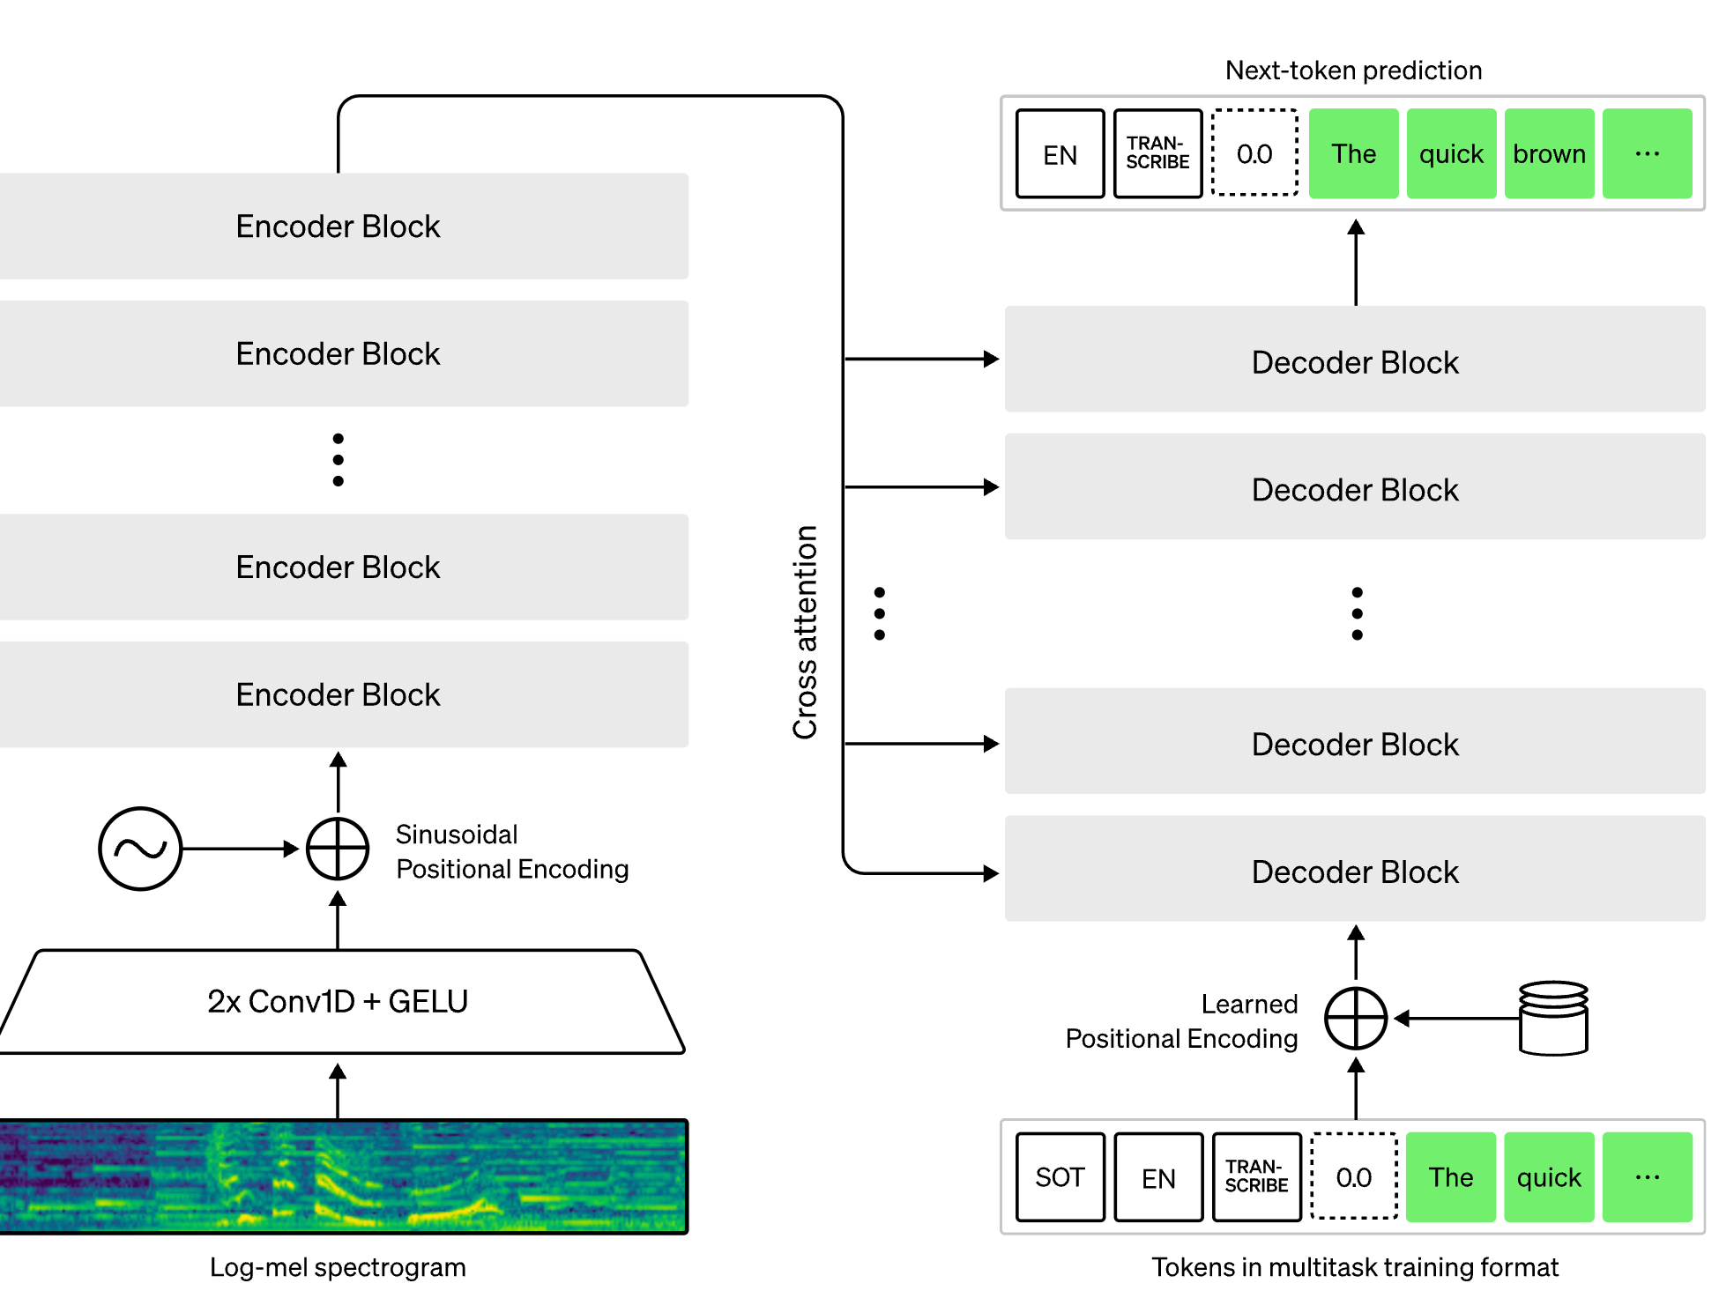

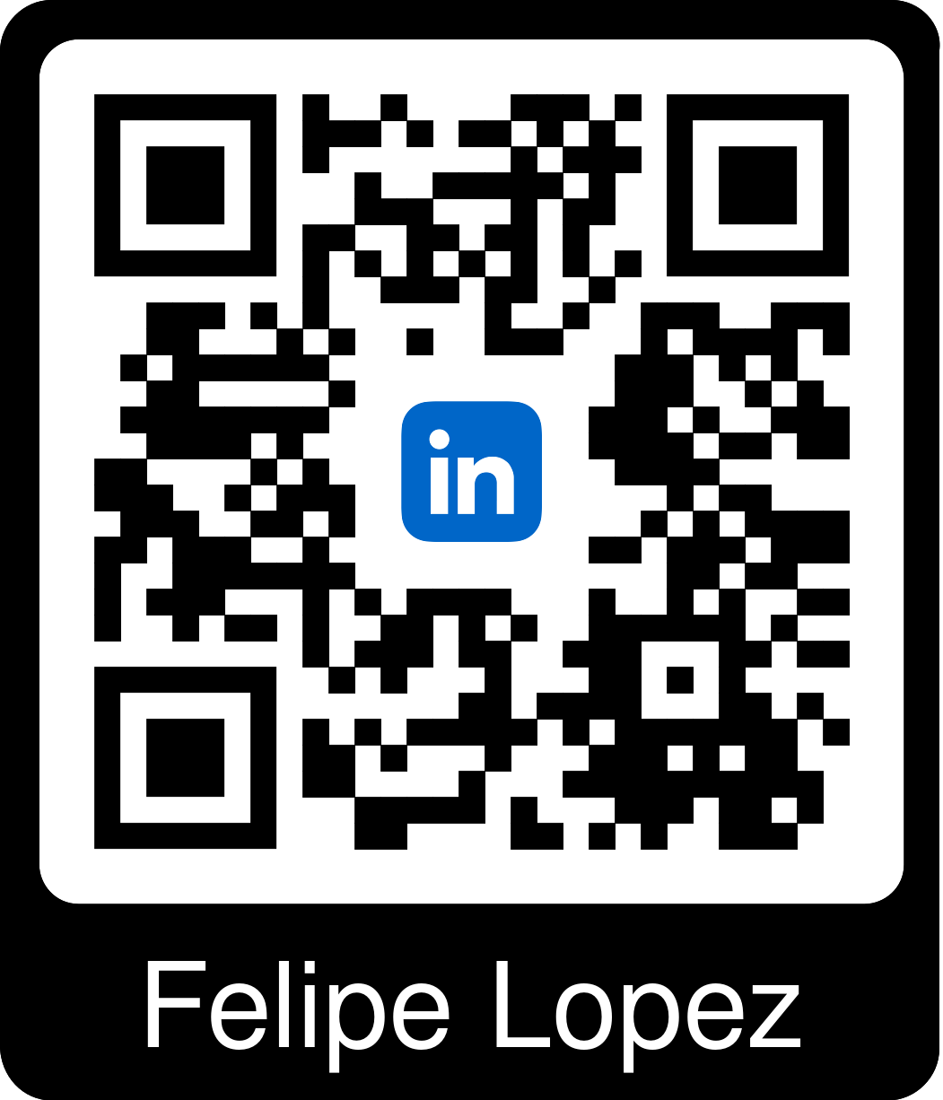

Scopes of Improvement
How it Works
Speaker 2 Language
Translated Language
Questions
Automatic Gender Recognition
Speech to Text Model
Transcribed Text
Translated Text
Speaker 1 Language
Automatic Language Recognition
Notes:
- STT MODEL - Tanu
- NEXT SLIDE -
-The “WhisperForConditionalGeneration” is a specialized machine learning model designed primarily for converting speech to text. A simpler explanation:
How It Works: The model has two main parts:
Encoder: This part listens to the speech and breaks it down into a format the machine can understand. It uses several layers and techniques to focus on important parts of the speech and understand the context.
Decoder: After the speech is processed by the encoder, this part translates it into written words. It ensures the text makes sense and keeps the original meaning of the speech.
Complex Processing: Both parts use advanced techniques like layers of neural networks, attention mechanisms (to focus on key parts of the speech), and layer normalization (to improve performance).
Output: In the end, the model outputs written text that represents what was spoken.

Slide 6
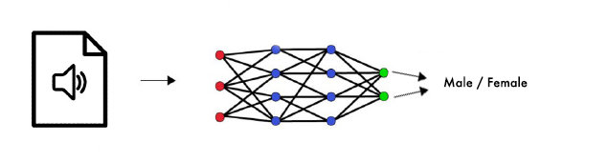
Scopes of Improvement
How it Works
Speaker 2 Language
Translated Language
Questions
Our Model
Speaker 1 Language
Automatic Gender Recognition
Transcribed Text
Translated Text
Automatic Language Recognition
Notes:
- GENDER RECOGNITION - Tanu
- NEXT SLIDE -

Slide 7
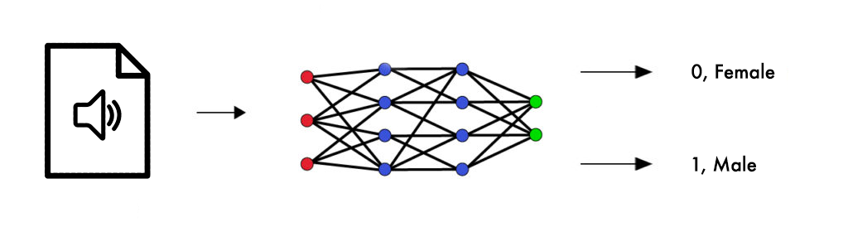
Scopes of Improvement
How it Works
Speaker 2 Language
Our Model
Translated Language
Automatic Gender Recognition
Translation
Speaker 1 Language
Transcribed Text
Translated Text
Automatic Language Recognition
Notes:
- TRANSLATION - David
- NEXT SLIDE -
It employs a robust matching algorithm, sourcing translations from various professionals and web content.

Slide 8
Scopes of Improvement
How it Works
Our Model
Translated Language
Automatic Gender Recognition
Text to Speech
Transcribed Text
Speaker 1 Language
Translated Text
Speaker 2 Language
Automatic Language Recognition
Notes:
- TEXT TO SPEECH - David
- NEXT SLIDE -
model : Wavenet
natural voice

Slide 9
How it Works
Our Model
Speaker 2 Language
Translated Language
Speaker 1 Language
Questions
Scopes of Enhancement
Transcribed Text
Overall Fine-tuning
Multiple Speakers Recognition
Language Identification
Sentiment Recognition
Accesibility
Range of Languages & Dialects
Jargons & Accents
Translated Text
Automatic Gender Recognition
Notes:
- ENHANCEMENT – Tanu
- NEXT SLIDE -
At the beginning, we had so many awesome ideas for our project, but due to time and budget constraints, we had to choose just one feature to work on for now. The exciting part is that as we gain more experience and time, we're really looking forward to going back and adding all those fantastic features we initially dreamed of. It's like starting with something great and knowing it's going to get even better down the road!

Slide 10
Speaker 1 Language
Our Model
Thank You !
Transcribed Text
Notes:
- FINISH – David
Grazzie for watching

